Slide 1
Data Analysis of Submeters Electric Power Consumption In Individual household
Itoro Etuks
July 3, 2019

Slide 2
Initial Report To IOT Client On Data Analytics Agenda
Welcome and Introduction - Itoro
Background of the project
Objective/Goals
Data Management
Descriptions and Location of Data
Descriptive Statistics Gathered
Known Issues
High-Level Recommendations
Questions & Answers

Slide 3
Background of the Project
To develop analytics for a new set of electrical sub-metering devices used for power management in Smart Homes for real estate development client.
Data Abstract:
Measurements of electric power consumption in one household with a one-minute sampling rate over a period of almost 4 years.
Different electrical quantities and some sub-metering values are available.
Data Set Information:
Archive of 2,075,259 measurements gathered in a house located in Sceaux (7km of Paris, France) between December 2006 and November 2010 (47 months).
(global_active_power*1000/60 - sub_metering_1 - sub_metering_2 - sub_metering_3) represents the active energy consumed every minute (in watt hour) in the household by electrical equipment not measured in sub-meterings 1, 2 and 3.
The dataset contains some missing values in the measurements (nearly 1,25% of the rows). All calendar timestamps are present in the dataset but for some timestamps, the measurement values are missing.

Slide 4



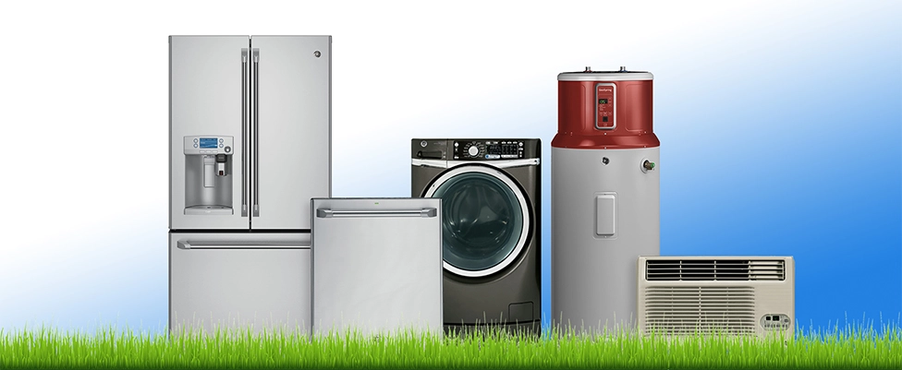
Background of the Project
Submetering Applications
Business Insights
What are Smart Homes?
In the context of our analysis project, we define a smart home as a residence that uses internet-connected devices to enable the remote monitoring and management of appliances and systems, such as lighting and heating, and power consumption.
Other Questions to Guide Our Analysis
Industry Players
What are the benefits to consumers?
Operational improvements and energy savings
Tenant billing
Compliance, sustainability, management reporting, and LEED/Energy Star
What kinds of power usage analytics are currently offered?
What can be learned from the analytics?
Fault detection, equipment alerts, and M&V

Slide 5
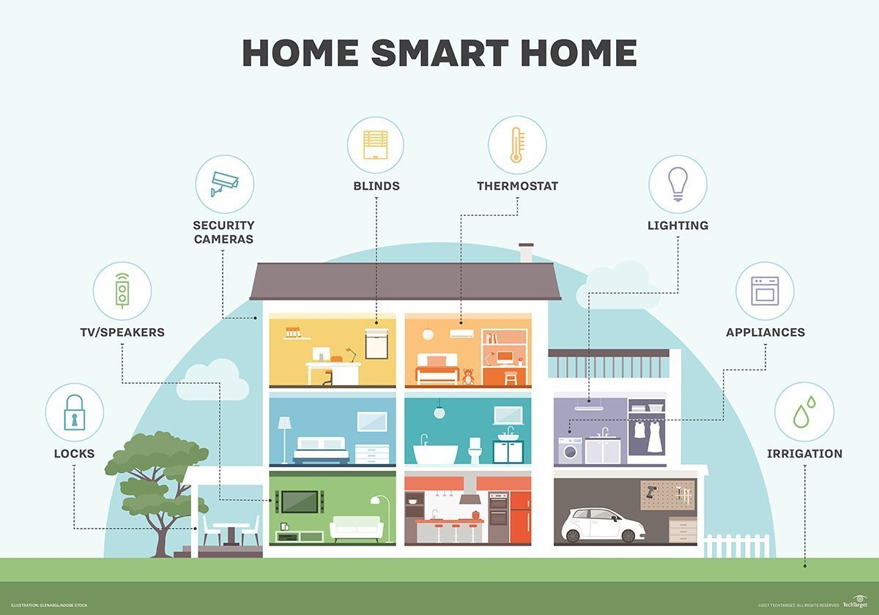
Background of the Project

Slide 6
Objective/Goals
Determine what kind of analytics and visualizations that would empower Smart Home owners with greater understanding and control of their power usage.
Our potential client’s goal is to offer highly efficient Smart Homes that provide their customers with power usage analytics. The analytics on these sub-meters will help them grow their business in the smart home market.

Slide 7
Data Management Report-Out
The following Data Management Approach will be taken to manage the data and security for the data during the project.
Data Extraction
Data Sets
Error Checking, Data Correction
Data Management Plans
Sample Selection and Recruitment
Data Security
Confidentiality
Data Backup
Archiving Documentation
Correctness of Data Analysis
Analysis Documentation

Slide 8
Descriptions and Location of Data
Location of Data: Data access is provided by client.
Data location: dbname='dataanalytics2018', host='data-analytics-2018.cbrosir2cswx.us-east-1.rds.amazonaws.com')
Description of Data:
Data Set Characteristics: | Multivariate, Time-Series | Number of Instances: | 2075259 | Area: | Physical
Attribute Characteristics: | Real | Number of Attributes: | 9 | Date Donated | 2012-08-30
Associated Tasks: | Regression, Clustering | Missing Values? | Yes | Number of Web Hits: | 288629

Slide 9
Descriptive Statistics Gathered
Which sub-meter is using the most power?
Sub_Meter_3 with Mean of 6.216 use most power
The least? Sub_Meter_1 uses the least power
Is there anything to learn from the max and min?

Slide 10
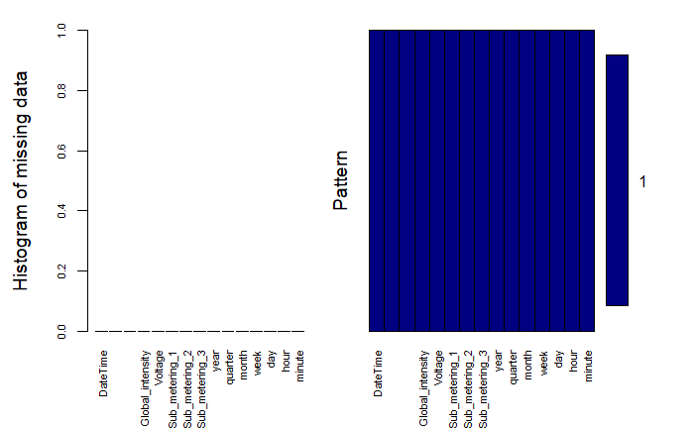
Descriptive Statistics Gathered Missing Data Analysis
The data set covers years 2006 to 2010
Year 2006 and 2010 contain missing or incomplete data.
Year 2006 is removed from further analysis and exploration
2007 to 2009 contains no missing data
This graph shows the pattern of data which confirms no missing data in all observations for the years selected for further analysis.

Slide 11
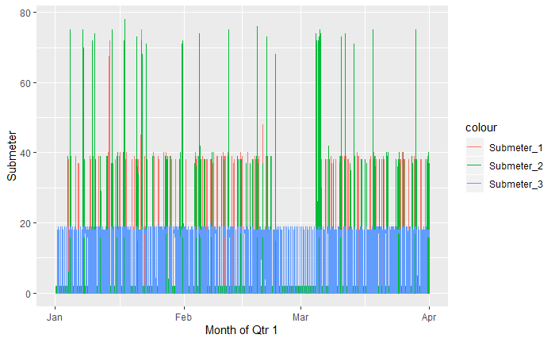
Frequency of usage comparison between all Submeters during Q1 of 2007
Descriptive Statistics Gathered
Sampling data by first quarter of 2007 (Qtr1_2007 Submeters Comparison)
Energy Consumption by Sub-Metering Areas (in active power watts)
Clearly, Submeter 3(electric water-heater air-conditioner) has highest energy usage
Submeter 2 (second highest)
Submeter 1: lowest usage
The colored lines shows distribution/frequency of usage in each Submeter during each month of Q1.
These lines represent how often energy is consumed across a Submeter each month.

Slide 12
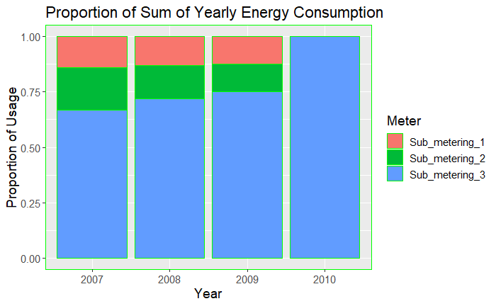
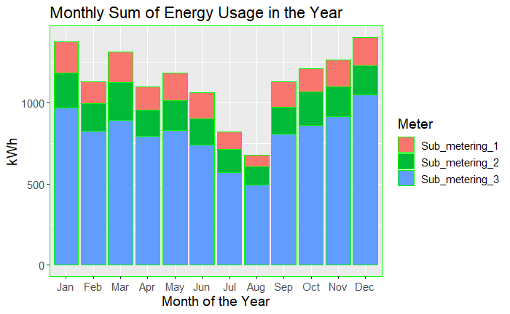
Descriptive Statistics Gathered Monthly and weekly comparison between submeters
Sum of all submeters energy consumption in each shows submeter_3 with the highest proportion of energy usage between 2007 and 2010
Submeter_2 and Submeter_1 show about equal proportion of energy usage in 2009 but slight disparities in 2007 and 2008
2010 only show energy consumption for Submeter_3.
Monthly comparison shows clearer contrast in energy usage between the three submeters.
Energy usage in all Submeters tends to rise in the beginning of the year and at the end of the year.
All three Submeters tends to follow a pattern in usage
A drastic drop in usage in all submeters between month of July and August.
Could the cause of drop in energy usage be capitalized across the year? Was it due to unforeseen external factor?

Slide 13
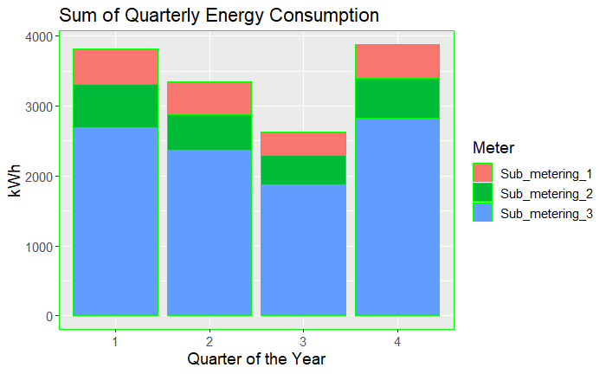
Descriptive Statistics Gathered
Sum of Quarterly Energy Consumption in a Year
Submeter_3 shows highest energy consumption across all quarters in a year
Higher energy usage in Q1 and Q4 of each year
Lowest energy usage in Q3
Why such a huge difference in energy usage between Submeter_3 and Submeter_2 and 1 combine?
At what in the day does energy consumption peeked?
What energy efficiency could be applied in Submetering_3 area?

Slide 14
Known Issues With Data
Lots of missing data in the original data set
The dataset contains some missing values in the measurements (nearly 1,25% of the rows
The missing value is represented by the absence of value between two consecutive semi-colon attribute separators.
Data set contain time not familiar in US.
How to Deal With Missing Data
Further Analysis is required to determine how to deal with missing data.
May need to take Mean, Median, or KNN of closest sample value to address missing value.
May need to delete rows or leave as is.

Slide 15
High-Level Recommendations Three or more recommendations about the existing data
Converting the data time zone to US
With such a big data set, focus the analysis on uncovering potential cost savings
The data is not as clean and must be cleaned for optimal analysis output
Data governance needs to be addressed
Analysis could be done on sample of the data set faster and for more in-dept analysis
Questions & Answers
Notes:
Paul
Here are a few of our lessons learned
These are universal, any project, anywhere
Know that you cannot skip steps

